Slide 1
Study for CAR# 163915963

Slide 2
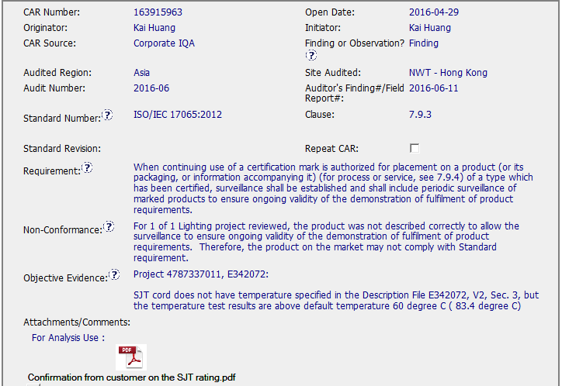
CAR 163915963
Finding - CAR
Excellent (1)
(L) Referenced communications are attached as needed.
Meet UL Value:
COLLABORATION
Meet CBS:
Communication
(1-1)
Communication with customer attached.
Background: Corporate IQA - FUS procedure error for power supply cord, Type SJT. Missing temperature rating for the SJT cord.

Slide 3
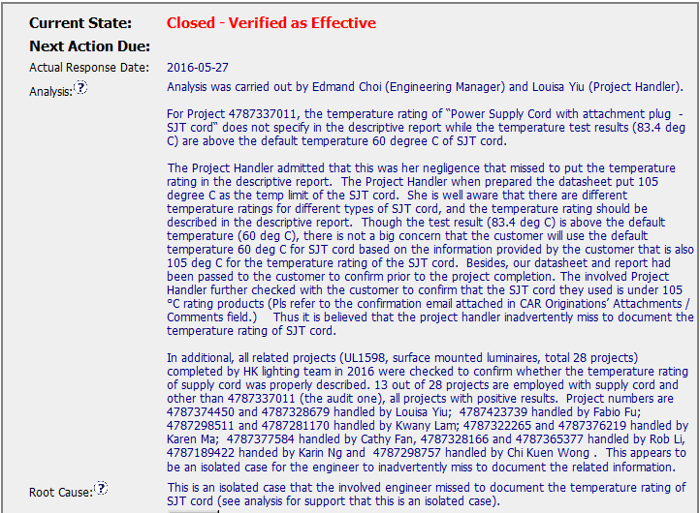
CAR 163915963 Analysis
Excellent (2)
(C) Analysis shows clear path to root cause and scope; stakeholders identified, (C) Root cause statement is succinct, reasonable, complete.
Besides, Objective Evidence shows in analysis.
Meet UL Value:
COMPETITIVENESS
Meet CBS:
Customer Focus
Achieve Business Results
Flexibility
(2-1)
Objective Evidence shows “negligence” (Datasheet information)
(2-2)
Objective Evidence shows Communication with customer attached.
(2-3)
Objective Evidence shows “isolated case” - reviewed other 28 projects
(2-4)
Root cause statement is succinct, reasonable, complete

Slide 4
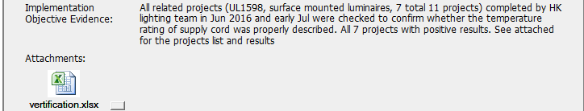
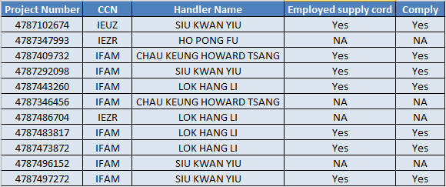
CAR 163915963 Owner’s Verification Admin’s Verification
Excellent (3)
(C) Milestones address containment & owner’s verification; completed per milestone expectations
(P) Verification per requirements
Meet UL Value:
COMPETITIVENESS
Meet CBS:
Customer Focus
Achieve Business Results
Flexibility
(3-1)
Milestone address the owner’s verification.
(3-2)
Additional project verified out of Owner’s verification.

Slide 5
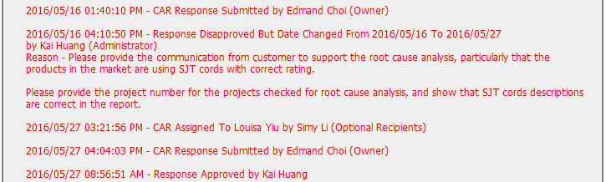
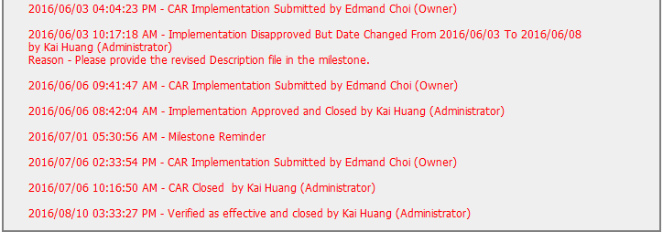
CAR 163915963 History Summary
Excellent (4)
(C) Extensions are within requirement (<30 days, 3 or less)
(T) Acts on CARs within required timeframe
Meet UL Value:
INTEGRITY
Meet CBS:
Initiative & Decision Making
Analyzing & Problem Solving
Excellent (4-1)
Extension are within requirement (< 30 days)
Excellent (4-2)
Extension are within requirement (< 30 days)
Excellent (4-3)
Act on CAR in required timeframe

Slide 6
CAR 163915963 – CBS Check
CBS Requirements | Excellent | Moderate | Need Improve | N/A
(C) Extensions are within requirement (<30 days, 3 or less) | √
(T) Most appropriate ‘category’, ‘type’, ‘geography’ are selected | √
(P) Facilitates the handling of disputed CARs |  |  |  | √
(T) Acts on CARs within required timeframe | √
(C) Analysis shows clear path to root cause and scope; stakeholders identified | √
(C) Root cause statement is succinct, reasonable, complete (Shows ‘N/A’ for observations) | √
(C) Corrective actions fix the objective evidence and other problems found; address entire root cause and scope. For observations, they do not go beyond fixing the objective evidence | √
(C) Milestones address containment & owner’s verification; completed per milestone expectations | √
(P) Verification per requirements | √
(L) Referenced communications are attached as needed | √
(C L) Evidence of communication for overdue/escalated CARs and other pertinent concerns |  |  |  | √
(P) Trains other CAR Champions |  |  |  | √

